Slide 1

Using an
Early Warning Data System (EWDS)
For Reducing Dropouts and
Increasing Graduation Rates
800-476-6861 | www.sedl.org
Copyright © 2013 by SEDL. All rights reserved.
No part of this presentation may be reproduced or transmitted in any form or by any means, electronic or mechanical, including photocopy, recording, or any information storage and retrieval system, without permission in writing from SEDL (4700 Mueller Blvd., Austin, TX 78723), or by submitting an online copyright request form at www.sedl.org/about/copyright_request.html. Users may need to secure additional permissions from copyright holders whose work SEDL included after obtaining permission as noted to reproduce or adapt for this presentation.

Slide 2
Objectives
Educators will
become familiar with the Early Warning Data System (EWDS) designed to help Texas districts and schools identify students who are at risk of dropping out and
review approaches for the systemic implementation required for interventions to reduce dropout rates and improve graduation rates.
2

Slide 3
Agenda
Texas graduation rate statistics
Key indicators of potential dropouts—the research basis of the EWDS
Early Warning Data System application
Systemic implementation of interventions
3

Slide 4
Texas High School Completion for 2012
 | Class of 2012
Number in Class | 316,758
Graduation Rate | 87.7%
Continued HS Rate | 5.0%
Received GED Rate | 1.0%
Longitudinal Dropout Rate | 6.3%
Data Source: Texas Education Agency. (2013). Secondary school completion and dropouts in Texas public schools, 2011-12 (Document No. GE13 601 05). Austin, TX: Author.
4
Notes:
Note:
Rates may not add to 100% because of rounding.

Slide 5
Texas High School Longitudinal Completion
Rates for Grades 9–12 for Class of 2012
Received GED Rate = 1.0 %
Continued HS Rate = 5.0 %
Longitudinal Dropout
Rate = 6.3 %
Graduation Rate
87.7 %
Data Source: Texas Education Agency. (2013). Secondary school completion and dropouts in Texas public schools, 2011-12 (Document No. GE13 601 05). Austin, TX: Author.
5

Slide 6

Let’s Do the Math . . .
316,758 — number of high school students
x 6.3% — longitudinal dropout rate
19,956 — number of students dropping out
6

Slide 7

What are the research-based indicators of potential high school dropouts?
7
Notes:
Optional Activity:
Ask pairs or tables to identify what they think are four dropout indicators. Share ideas.

Slide 8
Key Indicators of Potential Dropouts
1. *Attendance
2. *Course performance
    Course failures
    Low grade point average (GPA)
    F’s in core courses and credits earned in 9th grade
  3. Failure to be promoted to the next grade
  4. Disengagement
  *High Yield
Attributed to the National High School Center’s resources:
Developing Early Warning Systems to Identify Potential High School Dropouts (2008; retrieved from
http://betterhighschools.org/pubs/documents/IssueBrief_EarlyWarningSystemsGuide.pdf) and
Approaches to Dropout Prevention: Heeding Early Warning Signs With Appropriate Interventions (2007; retrieved from
http://www.betterhighschools.org/docs/NHSC_ApproachestoDropoutPrevention.pdf)
8

Slide 9

Early Warning Data System
EWDS is a database application that
allows importing of student data,
supports multiple campuses/cohorts,
provides multiple report options,
tracks interventions, and
integrates with Microsoft Excel.
This application is available for use free of charge.
Located on the Texas Comprehensive Center Website:
http://txcc.sedl.org/resources/ewds/
9
Notes:
The Early Warning System (EWS) Tool was originally developed by the National High School Center (NHSC) at the American Institutes for Research (AIR) to calculate automatically the high-yield indicators related to dropout. With permission of and in collaboration with the NHSC, the Texas Comprehensive Center (TXCC) at SEDL adapted the EWS Tool to produce an online customized database version called the Early Warning Data System (EWDS).
Begin the demonstration. See the 12-step EWDS demonstration to guide the presentation.

Slide 10
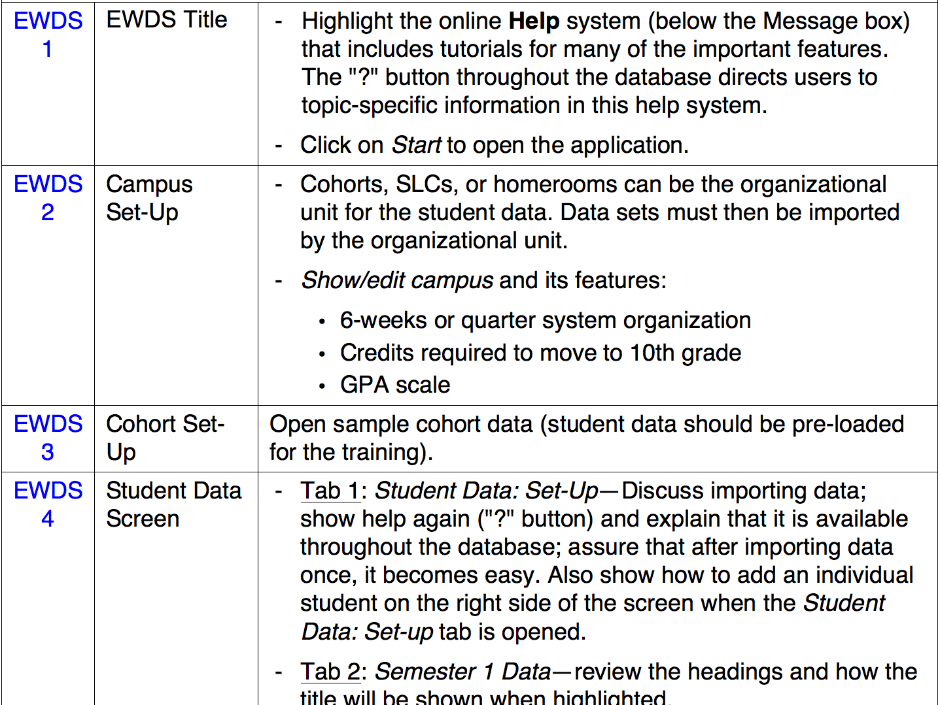
Early Warning Data System Overview
10
Notes:
This handout lists 12 important steps that should be demonstrated for interested educators. When time allows, the educators should also duplicate these steps on their computers to demonstrate that they can perform the basic functions of the EWDS.

Slide 11

Planning and Implementing Successful Dropout Prevention Interventions
11

Slide 12
To Determine the Leading Dropout Indicators for a Specific School . . .
Generate the data from the EWDS
Review possible interventions in the EWDS
Authenticate the success of the interventions using the EWDS data a
Develop intervention adjustments to meet the students’ needs more effectively
12
Notes:
These four steps can guide a school in implementing successful interventions that motivate students to graduate from high school.

Slide 13

GRADuation
1st – Generate data
Collect student data in the EWDS:
Attendance*
Course performance*
Failure to be promoted
Disengagement
*High yield
13
Notes:
The first step is to review a school’s data to determine the area of greatest need. This would be the place to begin the planning and implementing of interventions.

Slide 14

Consider the Reasons . . .
If, for example, attendance is the most prevalent indicator of the four at the school . . .
one would need to determine why students are absent from their high school.
Think about what the
reasons might be. . .
14
Notes:
Optional Activity: Reasons that students are absent
Ask participants to work together in pairs (or table groups) and determine 3 reasons students are absent and write each one separately on a sticky note. One person from the group posts the three sticky notes on the poster paper or designated wall area using these guidelines:
Post them in either the “excused” or “unexcused” area
Position them with similar reasons
Review the variety of reasons, emphasizing that no single intervention could impact all examples.

Slide 15

After Determining the Leading Dropout Indicator by Reviewing EWDS Data . . .
1st – Generate Data
2nd – Review appropriate interventions
Consider one indicator at a
time until interventions are
well implemented.
Consider 2 to 3 interventions
for each indicator.
15
Notes:
A single indicator should be the focus at the beginning of the process — because a data-driven, collaborative system should be implemented and establishing one can take time.
Two or three interventions are recommended for the selected indicator, in order to meet the majority of needs identified in the school’s data research — refer back to the variety of reasons for absences.

Slide 16
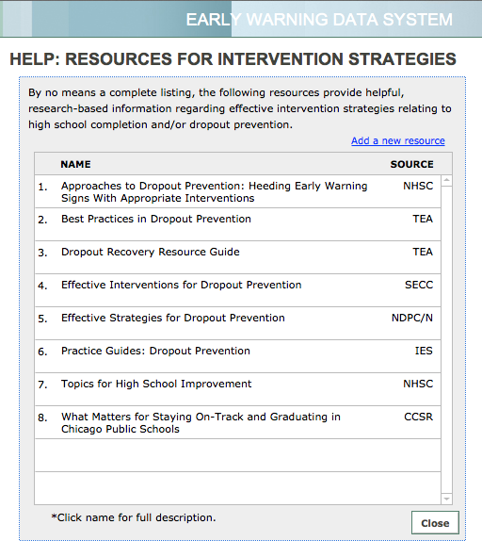
EWDS Lists Some Resources
16
Notes:
The EWDS provides a sample of resources from research if one is seeking additional ideas.

Slide 17
Dropout Prevention Interventions
Catch-up courses
Equal access to rigorous coursework
Extended learning time
Multiple paths to graduation; time and location options
Tutoring
Block scheduling
8th to 9th grade transition programs
Homeroom system
Ninth-grade academies
Small learning communities
Tiered interventions
Attendance monitors
Behavior monitors
Benchmarking
Progress monitoring
Career/college awareness
Counseling/mentoring
School climate monitoring to ensure it addresses student engagement
Wrap-around social services
Family and community engagement
17
Notes:
These are some of the interventions frequently found in high-performing schools listed in the research.
The next slide will show the interventions found in the lowest performing schools.

Slide 18
Dropout Prevention Interventions
Catch-up courses
Equal access to rigorous coursework
Extended learning time
Multiple paths to graduation; time and location options
Tutoring
Block scheduling
8th to 9th grade transition programs
Homeroom system
Ninth-grade academies
Small learning communities
Tiered interventions
Attendance monitors
Behavior monitors
Benchmarking
Progress monitoring
Career/college awareness
Counseling/mentoring
School climate monitoring to ensure it addresses student engagement
Wrap-around social services
Family and community engagement
18
Notes:
These are the same interventions, because it is how they are implemented, authenticated, and then developed or adapted that makes them successful for students.

Slide 19
Make the Difference Between an Effective and Ineffective Intervention
GRADuation
3rd – Authenticate the implementation and impact of the intervention
4th – Develop intervention adjustments to meet the students’ needs more effectively
19
Notes:
These two steps are the key to successful interventions. Two types of data can be tracked — implementation data and impact data.
Using these data, an intervention can be adjusted to meet student needs more effectively.

Slide 20
Examples of Authenticating Implementation of Tutoring
    Authenticate the tutoring program’s
    attendance and demographics
    to ensure that all student subgroups are represented and
    alignment between tutoring and course work
    to ensure the tutoring impacts students’ classroom work
20
Notes:
Here are some examples of implementation data.

Slide 21
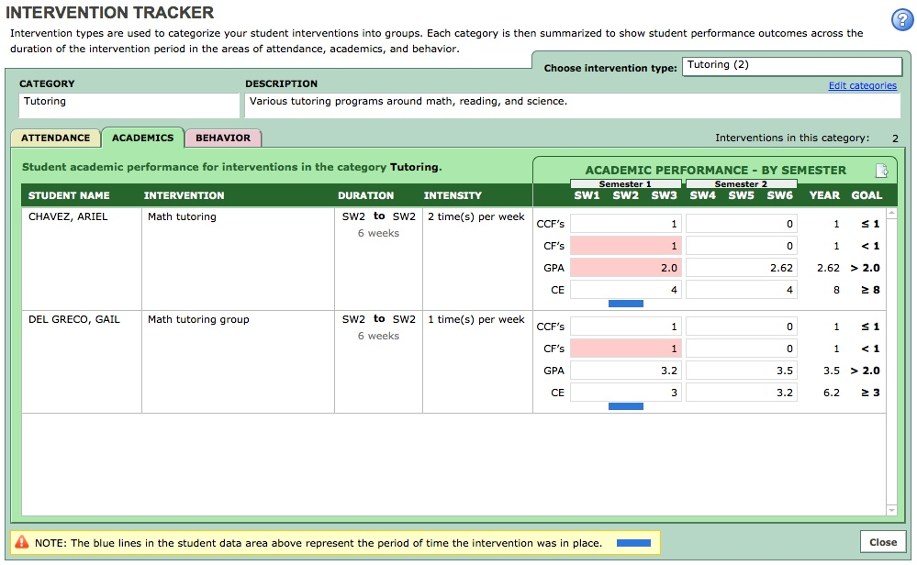
Example of Authenticating Impact of Tutoring
21
Notes:
Here are some examples of impact data in the EWDS. The reduction of F’s is clearly shown when the red flags disappear later in the school year.

Slide 22
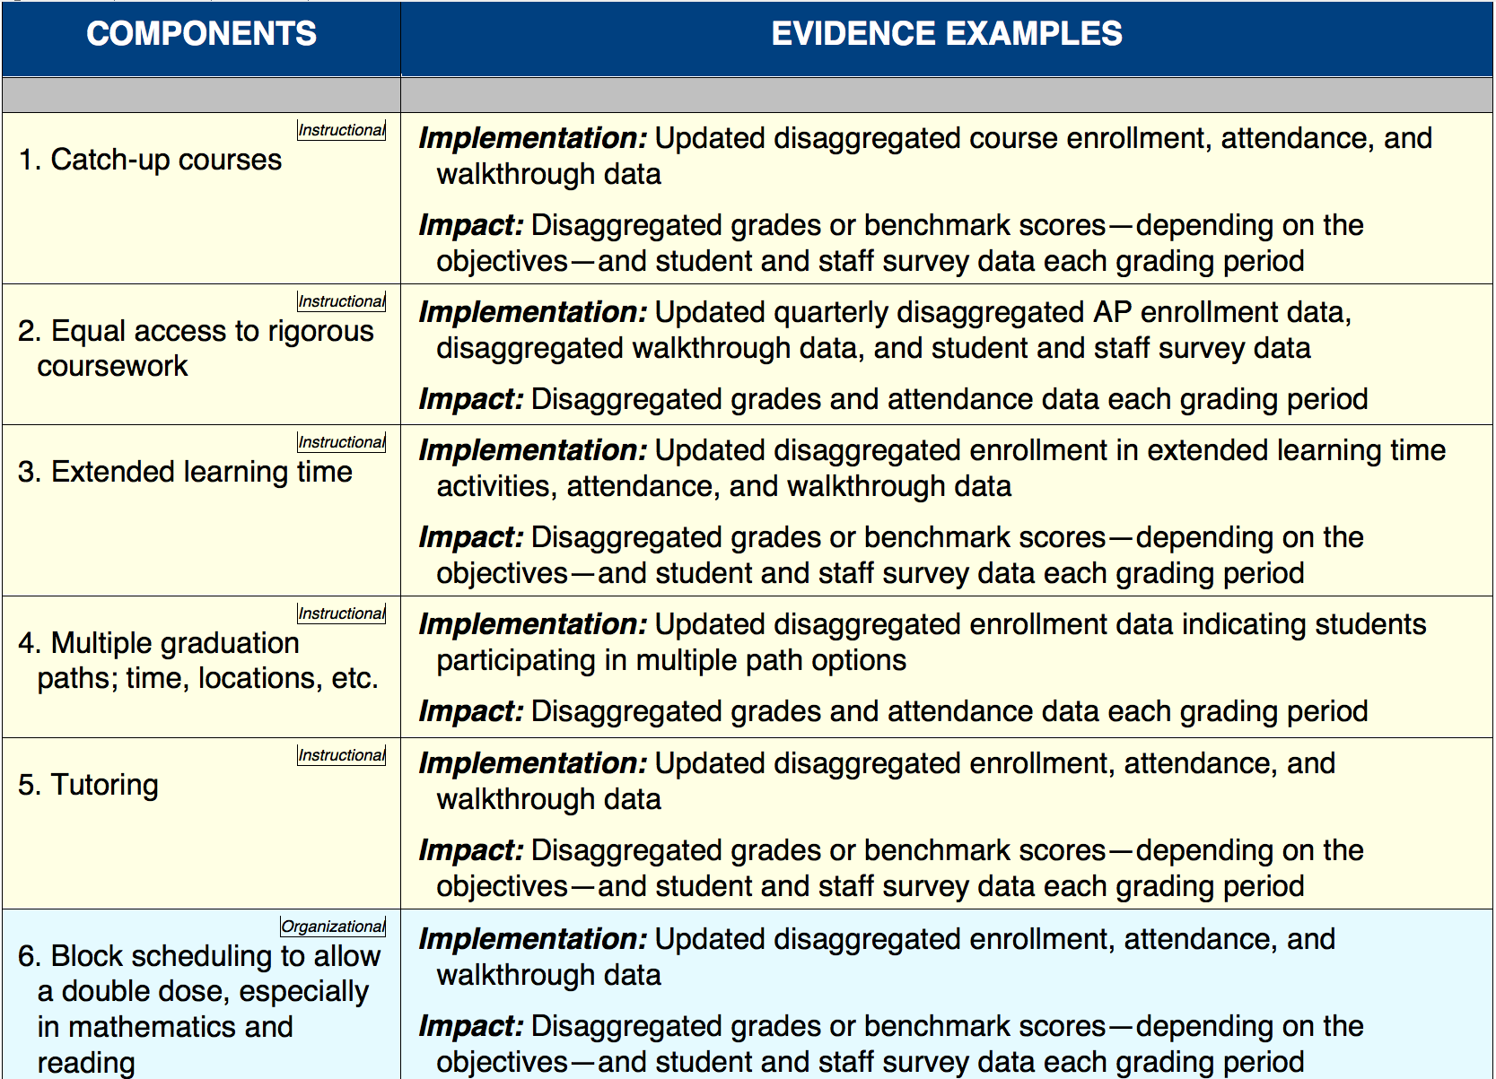
Dropout Prevention Intervention Examples
22
Notes:
This is one of the handouts and it shows some of the possible interventions that high schools use. They are grouped, as noted by the small box in the left hand column, as to the type of interventions.
The type of intervention can be helpful in several ways:
1. It allows for reviewing possible options after one has collected data for the school
2. Interventions in the same category can be verified by using the same or similar
data, thereby simplifying the verification process.

Slide 23

Consider Designing Interventions for . . .
individual students
groups of students
the entire school
23
Notes:
Optional Activity:
Divide the group into three groups. Ask each to design one of the following tutoring interventions:
1. for an individual
2. for groups of students with similar needs or assignments
3. for the entire school
Ask each group to describe their intervention and how they would measure its implementation and impact.

Slide 24

Generate data
Review interventions Authenticate
Develop the intervention
and
can together guide all students to graduation.
24
Notes:
By combining the EWDS tool and a data-driven system, schools can increase their graduation rate.

