Slide 1
Mind the Gap:
Closing the Achievement Gap
in Rural Districts
Shelley H. Billig, Ph.D.
RMC Research Corporation
November 2014

Slide 2
Agenda
Fast Facts – a quiz
What Works – for rural districts
  Dialogue using the Broad Foundation Framework for Urban District Excellence
    What works in teaching and learning
    What works in leadership and governance
    What works in organizational structure and culture
National Initiative
Q and A

Slide 3

Fast Facts
True or false: Rural districts comprise more than half of all of the districts in the United States.

Slide 4
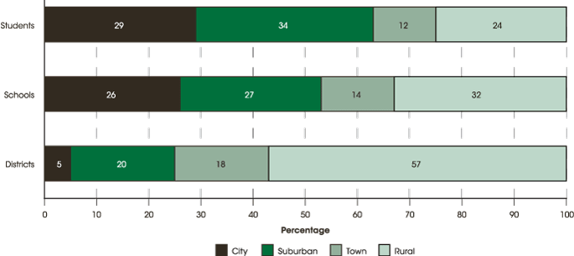
Look at the distribution of rural districts! –– School Year 2010-11 (NCES, 2013)

Slide 5
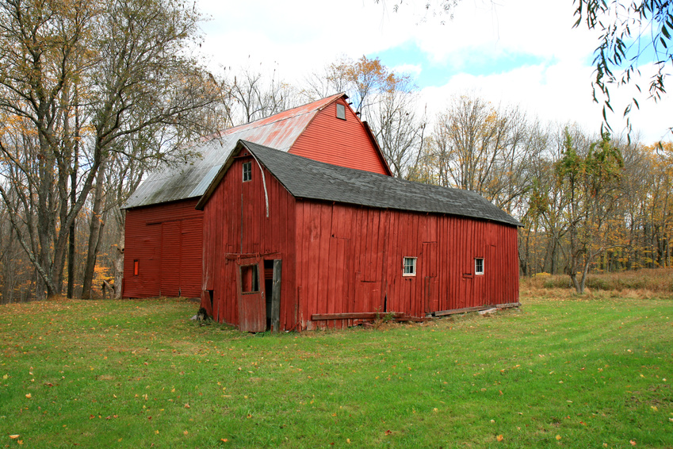
Fast Facts
True or false: Hispanics comprise the largest percentage of rural students in the United States.

Slide 6
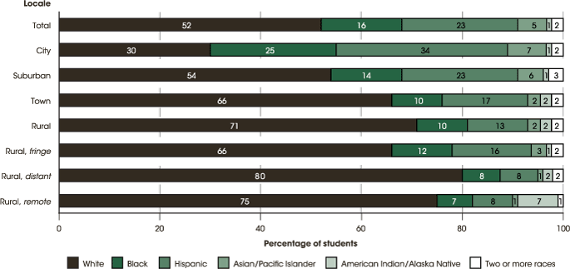
Rural student subpopulations in 2010-11 (NCES, 2013)

Slide 7

Fast Facts
True or false?
  The South has more rural child poverty than any other region of the U.S.

Slide 8
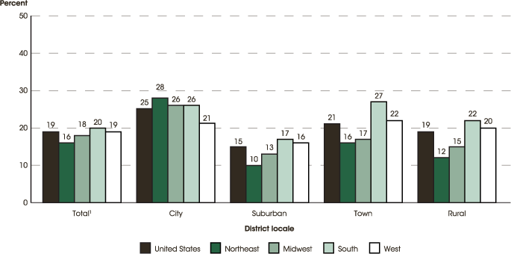
Percentage of 5- to 17-year-olds in families living in poverty, by district locale and region: 2010 (NCES, 2013)

Slide 9
Fast Facts
True or false? Rural schools have higher percentages of students who score proficient and advanced than urban schools.

Slide 10
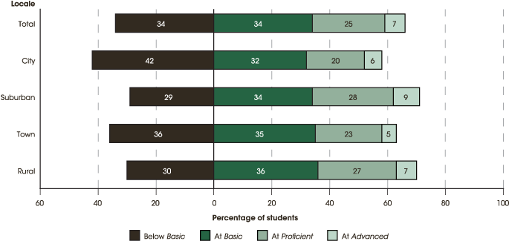
2011 NAEP reading achievement 4th grade (NCES, 2013)

Slide 11
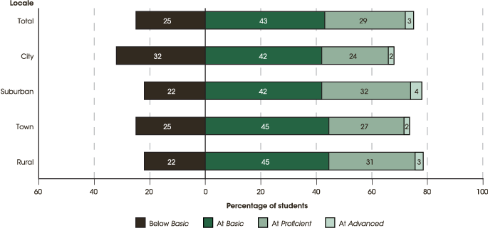
2011 NAEP reading achievement
8th grade (NCES, 2013)

Slide 12
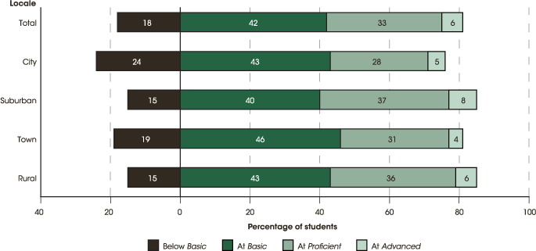
2011 NAEP Math Achievement 4th grade (NCES, 2013)

Slide 13
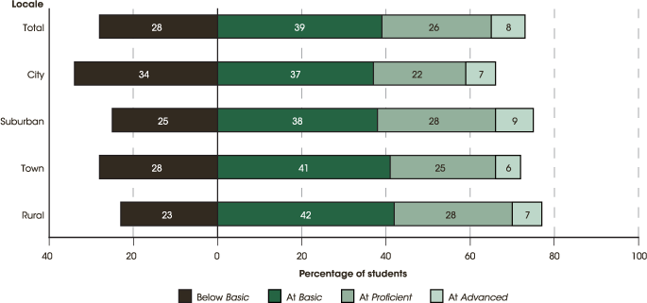
2011 NAEP Math Achievement 8th grade (NCES, 2013)

Slide 14

Fast Facts
True or false: Rural students are less likely to graduate than their urban peers.

Slide 15
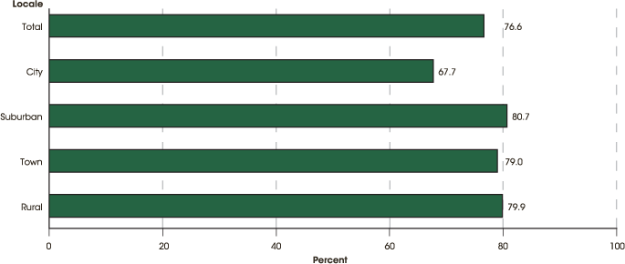
Freshman Graduation Rate, Entering 2008-09 (NCES, 2013)

Slide 16

The good news….
Rural districts are doing rather well. Students are generally doing better than their urban counterparts and slightly less well than their suburban counterparts.

Slide 17
The not-so-good news
Most rural districts still have a relatively large achievement gap.
Achievement gaps for rural districts are nearly the same as for urban districts and in some regions, surpass urban districts (Rural Trust, 2013)

Slide 18
So what works?
Not much research specifically addressing rural achievement; even less that focuses on the rural achievement gap
But there is some!

Slide 19

Let’s discuss
The Broad Framework for Urban District Excellence is based on the research literature on what works in urban districts. Do these same strategies work in rural districts?
Note that these are
district practices.

Slide 20
Practitioner Wisdom Table Assignments
Each table will be assigned to work on two areas:
  1 – Curriculum and Instruction
  2 – Assessment and Professional Development
  3 – Instructional Leadership and District
  Governance
  4 – Strategic Planning and Performance/
  Accountability
  5 – Human Resources and Financial Resources
  6 – Organizational Structure and Organizational
  Culture

Slide 21
How to Read the Framework
The indicator is the umbrella statement. The elements add up to the indicator.
EG - INDICATOR C-1. The district has a rigorous, effectively articulated standards-based curriculum and sufficient materials and curricular supports to implement the curriculum effectively.
The district has a core academic curriculum that has rigorous student performance expectations defined for each content area.
The district ensures that all teachers and students have standards-aligned instructional materials, including technology, needed to implement the curriculum in all content areas and all grade levels.
The district provides effective curricular supports, such as scope and sequence or pacing guides, and ensures that teachers can effectively teach the curriculum at the appropriate level of depth in the time available.

Slide 22
With your table partners, address the following:
Does the indicator and its elements apply to rural districts?
  If not, what needs to be changed?
Are there any missing indicators in the category?
  If so, what are they?
  Please appoint a note-keeper. We will debrief!

Slide 23
Debrief
Did the indicators and elements fit? What would you change?
What, if anything, was missing?
I’ll add some pieces from the research literature review we are undertaking….

Slide 24
Next Steps:
Kicking off a national effort to identify what works in closing the achievement gap in rural districts
Research review – 1270 articles reviewed so far
States are developing their own frameworks and some are planning a prize
A series of webinars are planned for “what works”
Over time, there will be a common framework, self-assessment tools, and a research agenda to address gaps in the literature

Slide 25
For more information
Please contact me at billig@rmcres.com
Questions?
Source: U.S. Department of Education, Institute of Education Sciences, National Center for Education Statistics. (2013). The status of rural education. Retrieved from http://nces.ed.gov/programs/coe/indicator_tla.asp

