Slide 1



Regional Institute
Supporting High-Quality Rural Education
November 6, 2014
Marion Baldwin, Program Associate
Afterschool, Family, and Community at SEDL
marion.baldwin@sedl.org
http://www.sedl.org/afterschool/iqa/
Copyright ©2014 by SEDL. All rights reserved.
No part of this presentation may be reproduced or transmitted in any form or by any means, electronic or mechanical, including photocopy, recording, or any information storage and retrieval system, without permission in writing from SEDL (4700 Mueller Blvd., Austin, TX 78723) or by submitting an online copyright request form at www.sedl.org/about/copyright_request.html. Users may need to secure additional permissions from copyright holders whose work SEDL included after obtaining permission as noted to reproduce or adapt resources for this document.

Slide 2

Supporting High-Quality
Rural
Education
Family Engagement in Rural Schools

Slide 3
Effective Family Engagement
  Helps families to understand what is expected of their children
  Provides families with information they need to support their children’s learning and healthy development
  Lets families know what they need to do to support their children’s education
Source: Ferguson, Jordan, & Baldwin, 2010, p. 12

Slide 4

Rural challenges and opportunities concerning family engagement

Slide 5
  Often rural schools serve many functions in addition to their primary mission of education.
  National Education Association

Slide 6
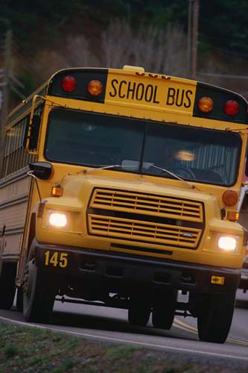
In rural North Carolina, what specific challenges regarding family engagement concern you?

Slide 7
  Rural schools have many strengths which can be leveraged…

Slide 8
  Contact Information
Marion Baldwin, Program Associate
marion.baldwin@sedl.org
800-476-6861
512-391-6503
www.sedl.org

